Slide 1
Machine learning
YKY

Slide 2
Spatial approximators
This class includes:
neural networks
SVMs (support vector machines)
approximator
The World
represented as vector points

Slide 3
Neural network
In a neural network, each neuron is a surface that classifies some points.
(This figure is only figurative)

Slide 4
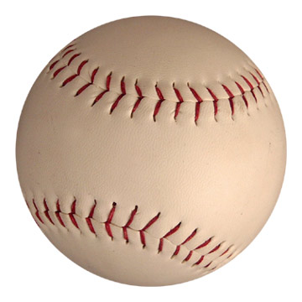

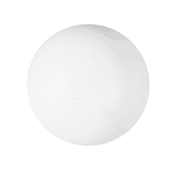
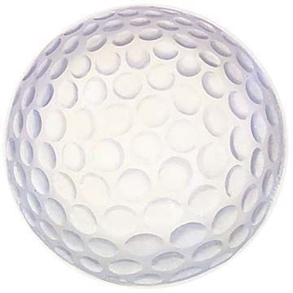
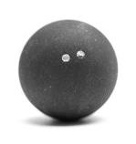
Logic-based “templates”
soft
heavy
light
hard
smooth
In a logic-based system, predicates (“templates”) can apply to multiple instances, thus achieving compression.

Slide 5
The cost of compression
Pattern matching is known as unification in logic:
a logic rule
body
→
head
If unifiable then
head is instantiated as new conclusion
attempt
unification
fact
new conclusion

Slide 6
The cost of compression
premise
new rule
match
new rule
KB
match
new rule
match
Deduction involves
iterative matching
conclusion

Slide 7
Logic-based approximation
It's hard to visualize geometrically...
KB

Slide 8
First order logic
Is FOL natural for embedding common sense?
The use of function symbols...
HOL (λ-calculus) is similar to FOL.
What about combinatory logic?
Can I say, 1 FOL rule = 1 morphism?
But even if that is true,

